Slide 1
HEART DISEASE PREDICTION
TSP- AI ML Fundamentals (Capstone Project)
Presented By: Shreya S R
NM ID: au810021214031
Guided By: Ramar Bose Sr. AI Master Trainer

Slide 2
OUTLINE
Problem Statement
Proposed Solution
Algorithm & Deployment
GitHub Link
Project Demo(video)
Conclusion
Future Scope
References

Slide 3
Problem Statement
A heart attack occurs when a heart vessel is blocked, leading to cell death in the affected area. Risk factors include age, gender, cholesterol, weight, and family history. Manual analysis is challenging due to numerous factors, making timely prediction crucial for saving lives. Symptoms of heart disease vary by gender and age.

Slide 4
Proposed Solution
Using logistical regression, we can create a model which predicts whether a person can get a heart disease based on various parameters such as age, gender, cholesterol, blood pressure , etc. the model will take input from the user and provide a simple verbal answer about wether or not one can get a heart disease

Slide 5
Algorithm & Deployment
Data collection and storage:
Kaggle was used, and the heart disease prediction dataset was downloaded.
Data Processing:
Various python libraries including NumPy, matplotlib, SciPy, Statsmodel API etc. are used
Model Evaluation and interpretation:
Google collab software is used to run the program and predict the results.

Slide 6
GitHub Link
https://github.com/shreyaSR-au810021214031/Naan-Mudhalvan-Heart_Disease_Prediction-Shreya-SR.git
YouTube link: https://youtu.be/1I19M80riqw

Slide 7
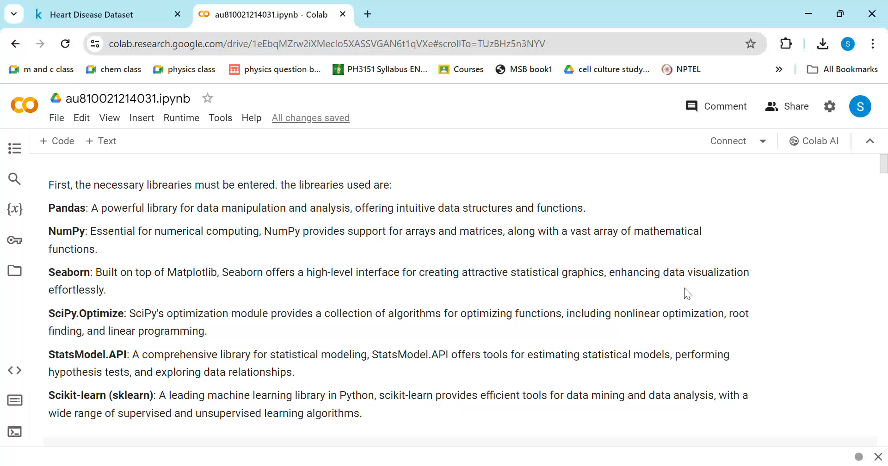
Project Demo(Recorded Video)

Slide 8
Conclusion
The data used in the project was found to be highly effective for the training of Artificial Intelligence and Machine learning. Based on the exploratory data analysis conducted, there seems to be very high correlation between the patients who have high cholesterol or get exercise angina (pain in the chest during or after exercise/strenuous activities) and those who have cardiovascular diseases. Thus, the given AI model is highly effective for finding out the more important parameters to predict heart disease in a given patient.

Slide 9
Future Scope
The future of Artificial intelligence in the prediction of heart diseases is very important. Simple yet powerful machine learning tools such as logistic regression can alter the course of human development by saving the lives of many people and work in the diagnosis of various illnesses which plague humanity. With further developments such as newer datasets with higher number of risk factors, more accurate results from highly sensitive and specific test results can help to improve the scope of this model. By promoting hospitals and other organizations to enter data into these models can help improve their accuracy over the course of time

Slide 10
References
Project Github link, Ramar Bose , 2024
Project video recorded link (youtube/github), Ramar Bose , 2024
Project PPT & Report github link, Ramar Bose , 2024

Slide 11
THANK YOU

